Slide 1





Credit card default prediction using ensemble methods
Project ID:32023
By
Name: Y.Chiki Rao Roll No:202361103
MCA-B
Name: Sujata Pradhan Roll No: 202361070
MCA-B
Name: Tadi.Sangeetha
Roll No:202365064
MCA-B
Name:Parmeswari Sahu
Roll No:202361071
MCA-B
Under the guidance of
Asish Kumar Roy
(202361103)&(202361070)&(202365064)&(202361071)
Notes:
B-TECH PROJECT MID-SEM PRESENTATION 2011
BY KHUSHBU KHAN & ISAN SAHOO

Slide 2
Topic to be discussed
Introduction
Objective of credit card default prediction
Overview of ensemble methods
SMOTE (Synthetic Minority Over-sampling Technique)
Random Forest Classifiers
XGBoosting Classifiers
Gradient boosting classifier
Ada Boosting
Model evaluation metrices
Baseline Model Comparison
Conclusion
Methods
Overview of Ensemble Methods
Overview of Ensemble Methods
Overview of Ensemble Methods
(202361103)&(202361070)&(202365064)&(202361071)
Notes:
B-TECH PROJECT MID-SEM PRESENTATION 2011
BY KHUSHBU KHAN & ISAN SAHOO
2

Slide 3

Introduction
Credit card default prediction is a critical task in the financial industry.
By accurately predicting defaults, institutions can manage risk, minimize
losses, and optimize lending strategies.
This Photo by Unknown Author is licensed under CC BY-ND
(202361103)&(202361070)&(202365064)&(202361071)

Slide 4

Objective of credit card default prediction
Objective:
The objective of this project is to develop a machine learning model for accurately predicting credit card defaults. By applying various ML algorithms, including ensemble techniques (e.g., Random Forest, Gradient Boosting etc.…), the project aims to enhance prediction accuracy, reduce false positives/negatives, and assist financial institutions in making informed credit risk decisions. The model will analyze historical customer data, including demographic and financial information, to identify key factors contributing to default risk.
(202361103)&(202361070)&(202365064)&(202361071)

Slide 5
Overview of ensemble methods
Definition:
Combines multiple models to improve prediction performance.
Types of Ensemble Methods:
Bagging: Multiple models are trained on different subsets of the data, and their predictions are averaged. e.g:-Random Forest, which reduces variance.
Boosting: Models are trained sequentially, with each model focusing on correcting the errors of the previous one. e.g., Gradient Boosting, which reduces bias by improving weak models.
Stacking: Combines different models to improve prediction.
(202361103)&(202361070)&(202365064)&(202361071)

Slide 6
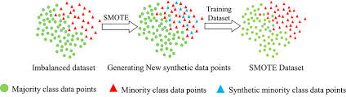
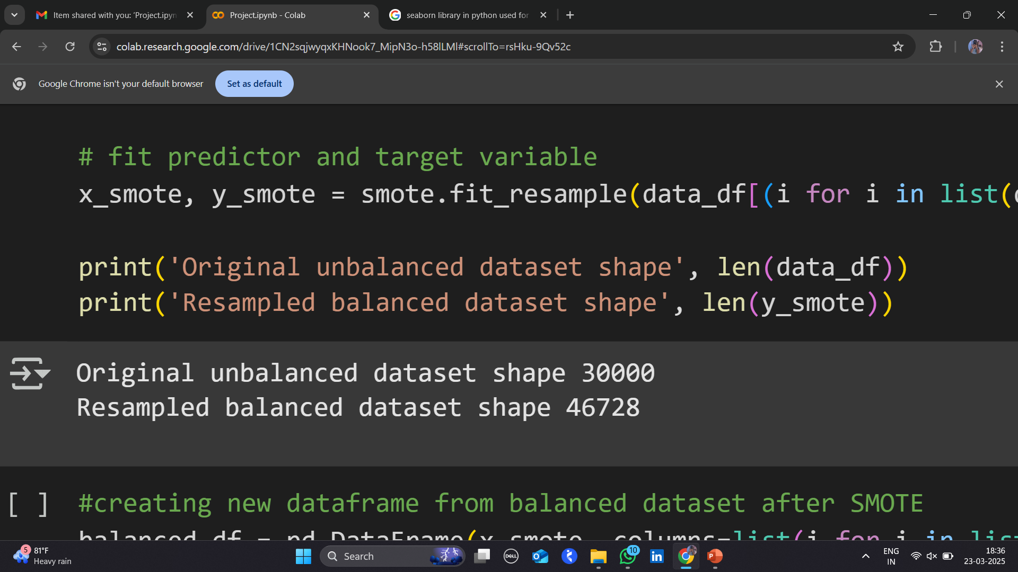
SMOTE (Synthetic Minority Over-sampling Technique)
Purpose: Addresses class imbalance by generating synthetic samples for the minority class.
How It Works:
Identifies minority class samples.
Selects nearest neighbors.
Creates synthetic samples by interpolating between samples and their neighbors.
Advantages:
Balances class distribution.
Reduces bias and improves model
performance.
(202361103)&(202361070)&(202365064)&(202361071)

Slide 7
Random Forest Classifiers
An ensemble learning algorithm that combines multiple decision trees
for classification or regression tasks.
How It Works:
Bootstrapping: Random subsets of data are created.
Tree Building: A decision tree is trained on each subset.
Prediction:
Classification: Majority voting.
Regression: Averaging predictions.
Advantages:
High accuracy and less overfitting.
Handles large datasets and missing values.
Works for both categorical and numerical data.
(202361103)&(202361070)&(202365064)&(202361071)

Slide 8
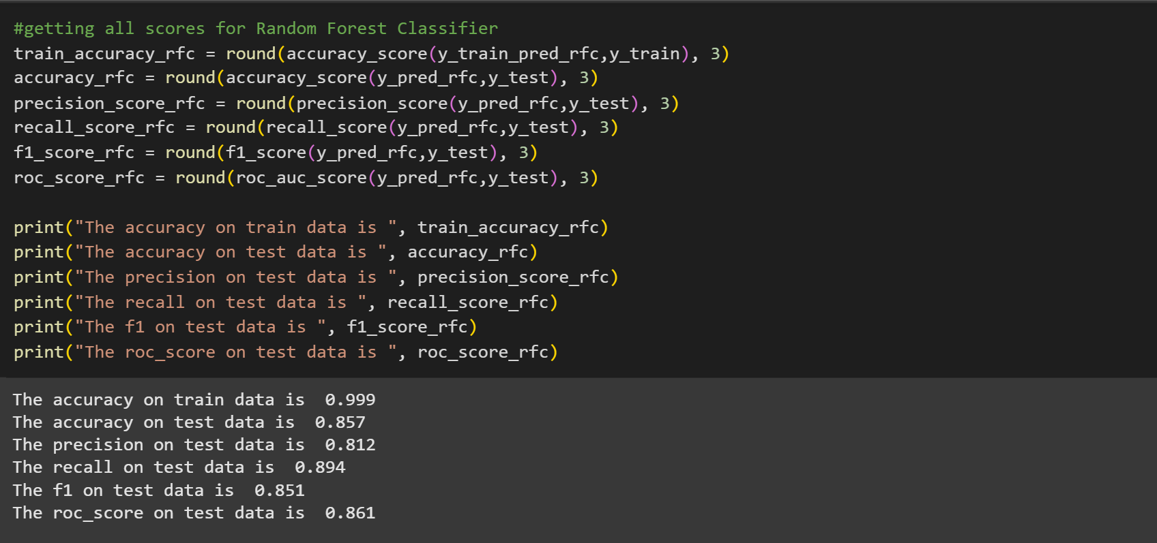
Accuracy Result of Random Forest Classifiers
(202361103)&(202361070)&(202365064)&(202361071)
(202361103)&(202361070)&(202365064)&(202361071)

Slide 9
XGBoosting Classifiers
XGBoost: Extreme Gradient Boosting
What is XGBoost?
A powerful, optimized machine learning algorithm based on Gradient Boosting, widely used for structured data and competitions like Kaggle.
Fast & Efficient (Optimized for speed & performance)
Handles Missing Values Automatically
Regularization (L1 & L2) to prevent overfitting
Supports Parallel & GPU Processing
Tree-based and Linear Model Support
Why Use XGBoost?
High Accuracy 📈 Scalable 📊 Handles Large Datasets 🔥
(202361103)&(202361070)&(202365064)&(202361071)

Slide 10
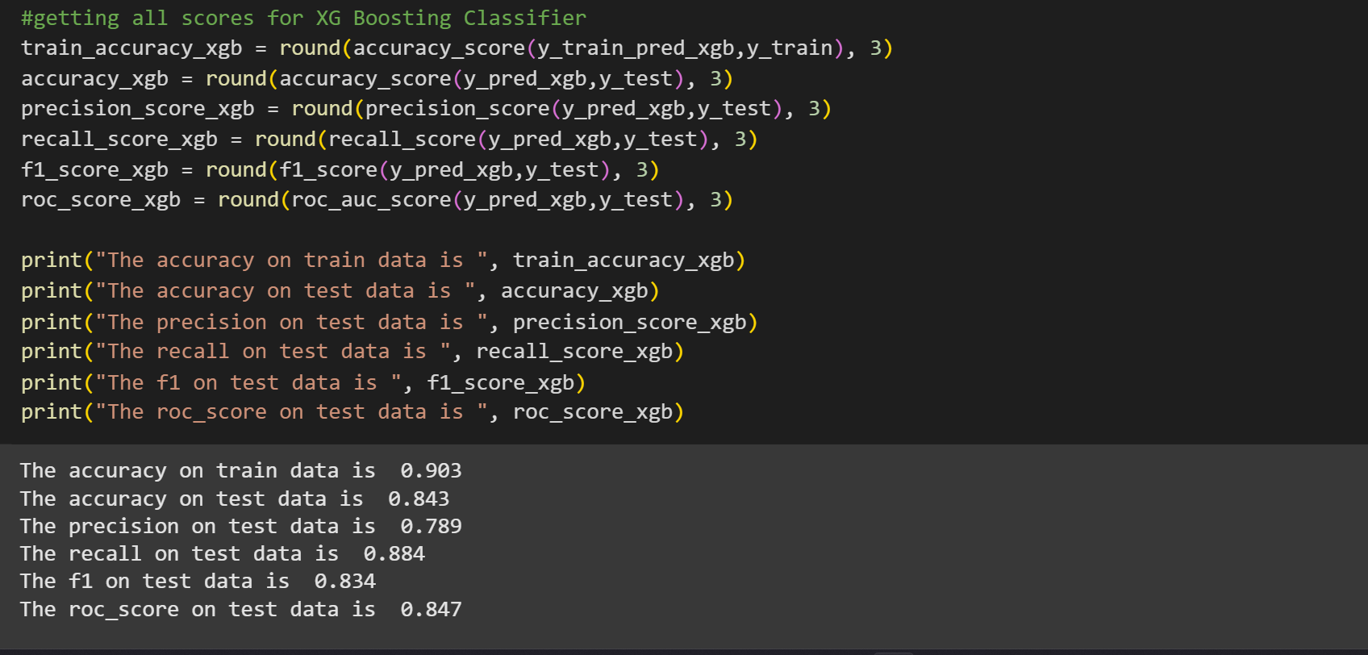
Accuracy Result of XGBoosting Classifiers

Slide 11
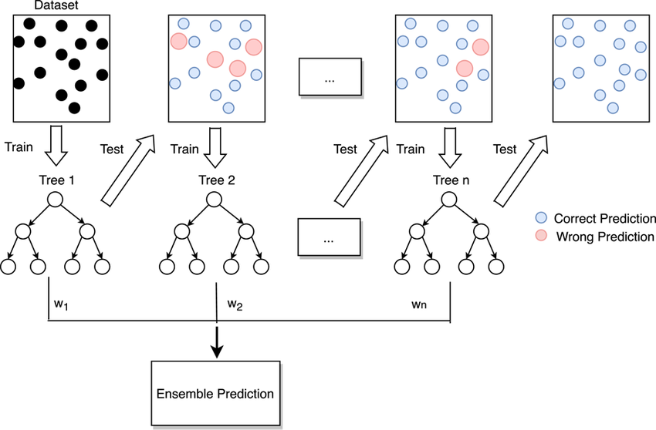
Gradient boosting classifier
Builds models sequentially, where each new model corrects the errors of the previous one.
Step-1:- A simple model is trained on the data.
Step-2:- The model's errors are calculated.
Step-3:- A new model is trained to focus on correcting the previous model errors.
Step-4:- This process is repeated iteratively until a desired level of accuracy is reached.

Slide 12
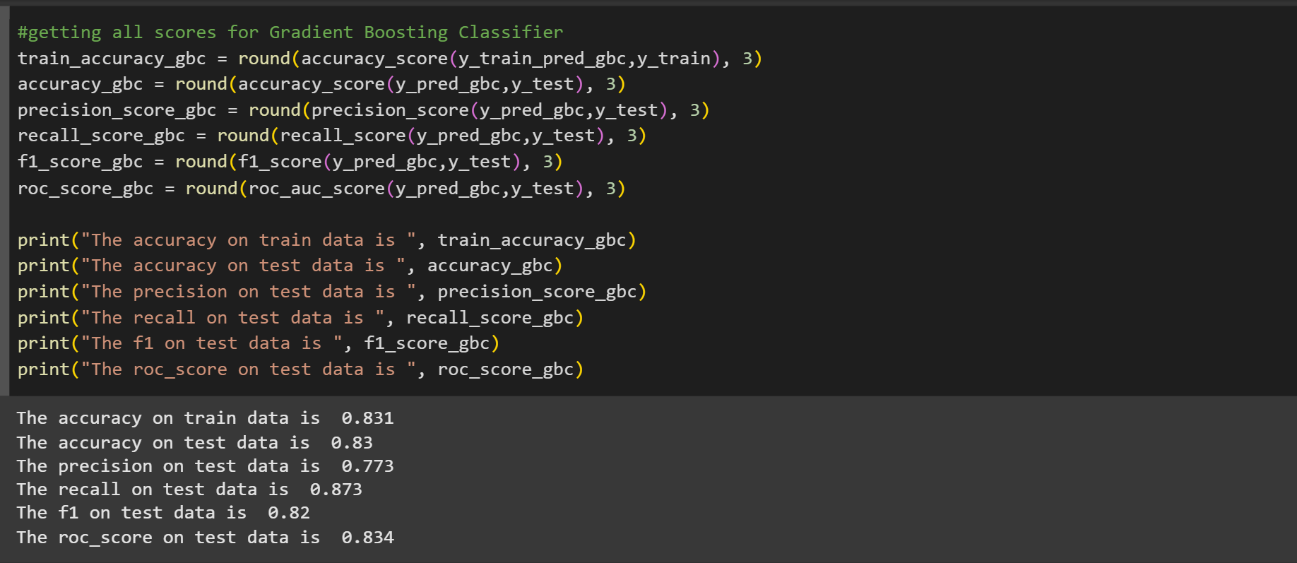
Accuracy Result of Gradient boosting classifier
(202361103)&(202361070)&(202365064)&(202361071)

Slide 13
Ada Boosting
AdaBoost is a boosting ensemble method used primarily for classification problems.
It combines multiple weak learners (often decision stumps) to create a strong
classifier.
Starts with equal weights for all training samples.
Trains a weak learner (e.g., a shallow decision tree).
Misclassified samples get higher weights so the next learner focuses on hard-to-classify points.
Assigns a weight to each weak learner based on its accuracy.
Final prediction is a weighted majority vote of weak learners.
(202361103)&(202361070)&(202365064)&(202361071)

Slide 14
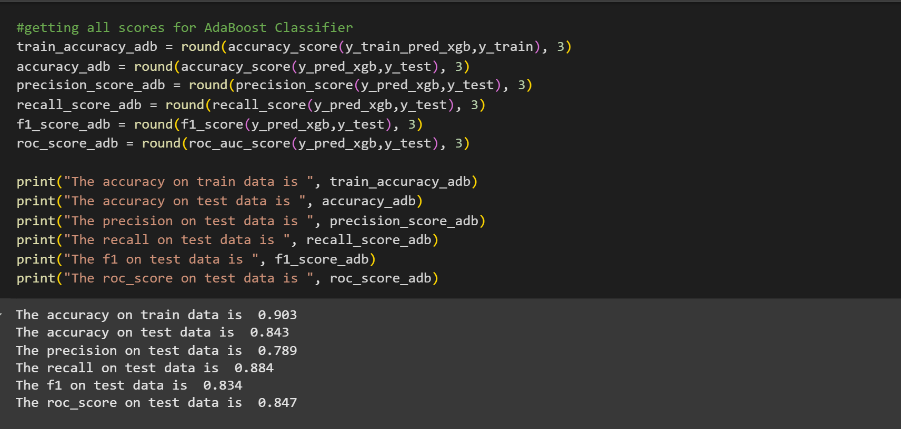
Accuracy Result of Ada Boosting
(202361103)&(202361070)&(202365064)&(202361071)

Slide 15
Model evaluation metrices
Model evaluation metrics quantify the performance of credit card default prediction models.
Accuracy
The proportion of correct predictions.
Precision
The proportion of true positive predictions among all Positive predictions.
Recall
The proportion of true positive predictions among all actual positive instances.
F1-Score
The harmonic mean of precision and recall, providing a balanced measure of performance.
(202361103)&(202361070)&(202365064)&(202361071)

Slide 16
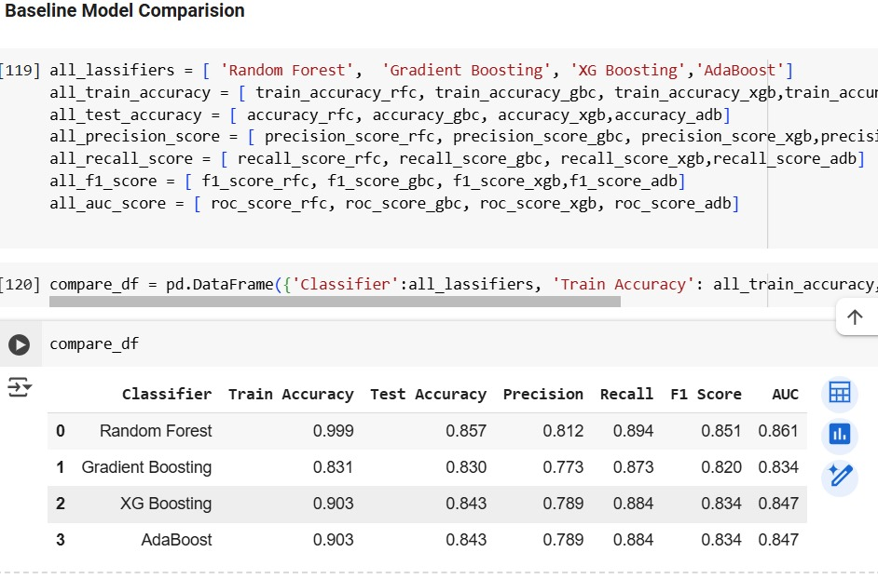
Baseline Model Comparison
A baseline model is a simple model used as a reference point. It helps to assess
whether a more complex model (like AdaBoost) is actually improving predictive
Performa
How to Compare Baseline and Advanced Models?
To compare models use:
Accuracy (for classification)Precision
Recall
F1-score (for imbalanced classes)
MSE
RMSE
R² (for regression)
(202361103)&(202361070)&(202365064)&(202361071)

Slide 17
Conclusion
Credit card default prediction is vital for managing financial risk.
Ensemble methods, along with logistic regression and decision trees, enhance prediction accuracy.
Proper evaluation and feature selection are crucial for building reliable models.
(202361103)&(202361070)&(202365064)&(202361071)

Slide 18
References
https://medium.com/swlh/predicting-credit-card-defaults-with-machine-learning-fcc8da2fdafb
https://www.sciencedirect.com/science/article/abs/pii/S2214785321035148
https://arxiv.org/html/2402.17979v1
https://www.researchgate.net/publication/354084428_Comparison_of_Different_Ensemble_Methods_in_Credit_Card_Default_Prediction

Slide 19
THANK YOU
(202361103)&(202361070)&(202365064)&(202361071)

